Slide 1

CPQ – Asia Alignment Design and Mock Up Nov ‘19
Colt confidential

Slide 2

Document Release and Change Log Details
CPQ Asia
Version Number | 0.3
Date | 06th Dec, 2019
Change log | SE Engagement scenarios Slide updates after internal review SE engagement scenario for ‘NG’ sites added

Slide 3
CPQ Asia : SE Engagement scenarios for Asia
Product Specific / Generic | SE Journey / Bespoke | Scenario | Region (EU/US, Asia, All) | Mandatory in Config / On Need Basis
Wave | SE Journey | Manual near-net is needed | EU/US, Asia (SGP) | Mandatory in Configuration
 |  | Dual Entry is needed (ULL Fibre, 3rd party leased line) | All | Mandatory in Configuration
 |  | Manual Off-net (ULL Fibre, 3rd party leased line) is needed | All | Mandatory in Configuration
 |  | Customer Defined Route is required | All | Mandatory in Configuration
 |  | Service Type requested by Customer is not available at the site for DC & RB | All | Mandatory in Configuration
 |  | Diversity feature is required | All | Mandatory in Configuration
 |  | Protected Resilience is required | Asia | On Need Basis
IP Access | SE Journey | If the Diversity is requested by the customer the Sales User must engage an SE | All | Mandatory in Configuration
 |  | When Customer Requires a “Specific Managed COLT Router” or “Specific Unmanaged COLT Router” _ This is not a mandatory SE engagement. Sales only engages SE, if support is required to fill the required information which are: a. Contractually Agreed Router? b. Router LAN Interface Type c. COLT CPE ID d. CPE Cost Currency e. Cost of CPE f. Router Model | All | On Need Basis
 |  | When the Manual Engagement response for a Non Colt Country back from ONQT team has access type = “3rd Party Leased Line”. | All | Mandatory in Configuration
All Products (Ethernet, Wave, IP Access) | SE Journey | For Japan, when Access type = 'Colt Fibre' | Asia (JP) | Mandatory in Configuration
All Products (Ethernet, Wave, IP Access) | SE Journey | For Japan, when NTT data coverage result is NG (Not Good) | Asia (JP) | Mandatory in Configuration
All Products (Ethernet, Wave, IP Access) | Bespoke | Any scenario not covered by standard or SE journey | All | Mandatory in Configuration
Product Specific / Generic | SE Journey / Bespoke | Scenario | Region (EU/US, Asia, All) | Mandatory in Config / On Need Basis

Slide 4
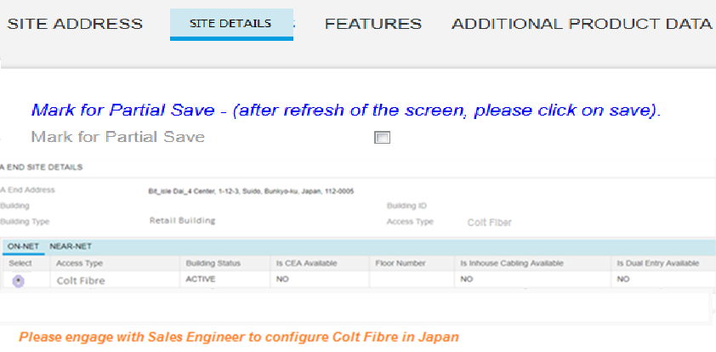
CPQ Asia : Colt Fibre Configuration in Japan
Sales User
Whenever sales user selects the Colt Fibre response for Japan, he will see a message on the screen “Please engage with Sales Engineer for Colt Fibre in Japan”
Sales user will then partially save and engage SE to complete Colt Fiber configuration in Japan.
Quote line-item stage will remain “Created”
Existing EU process for Sales to engage SE will be used in Asia too.

Slide 5
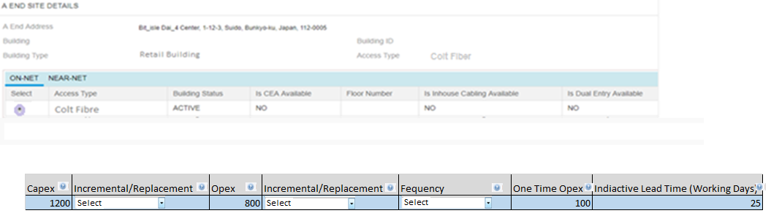
CPQ Asia : Colt Fibre Configuration in Japan
Sales Engineer
Colt Fibre Additional Charges
SE will see a section for Colt Fibre Additional Charges . This section has Capex , Opex , One time opex and indicative lead time fields presented to the SE
Introduction of one time opex has to be done across all the SE journeys. It should not have Incremental/ Replacement and Frequency columns
SE works with Network planning team offline to get the info- cost, capacity check, indicative lead time.
SE will work closely will sales in case the Colt Fibre option is not available for the request raised. The alternatives will discussed and accordingly SE can configure the ULL Fibre option
If additional cost is entered by SE, the line-item will change to “Additional cost required” stage and will be sent to deal pricing
If there is no additional cost added by SE and there are no other line-items requiring deal pricing approval, quote can be self approved by Sales.
When quote is saved and sent back to Sales, fields are visible to Sales users in line-item grid but as read only.

Slide 6
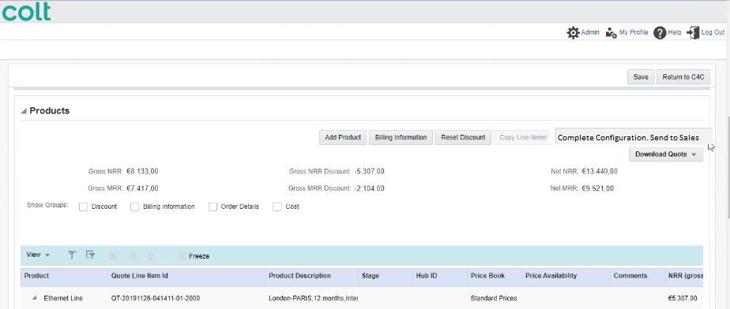
CPQ Asia : Colt Fibre Configuration in Japan
Sales Engineer
Once SE complete the configuration, he will have to click on the ‘Complete Configuration. Send to Sales’ button. This will send the Opex and Capex details to sales

Slide 7
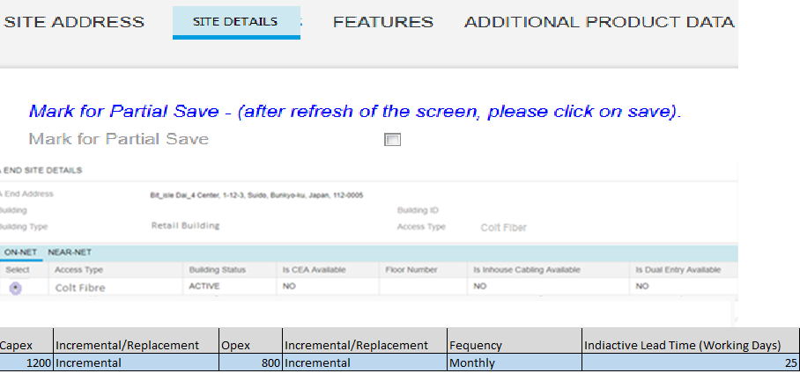
CPQ Asia : Colt Fibre Configuration in Japan
Sales
Once SE send back the quote to Sales then Sales will see the see the Capex and Opex vales entered by SE in the read only mode
Colt Fibre Additional Charges

Slide 8
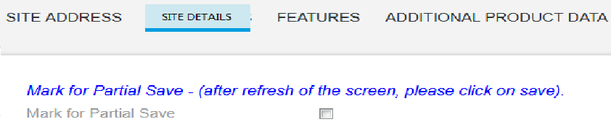
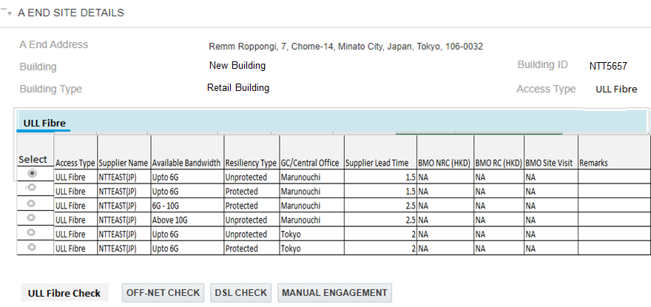
CPQ Asia : ULL Connectivity in Japan
Sales
In case the selected ULL Fiber record is marked as ‘NG’ in the NTT Dataset then CPQ will provide a message to the user that ‘Please engage SE as the selected site is indicated as a Not Good (NG) by the supplier’
Sales user will then partially save and engage SE to complete ULL Fiber configuration in Japan.
Quote line-item stage will remain “Created”
Please engage SE as the selected site is indicated as a Not Good (NG) by the supplier

Slide 9
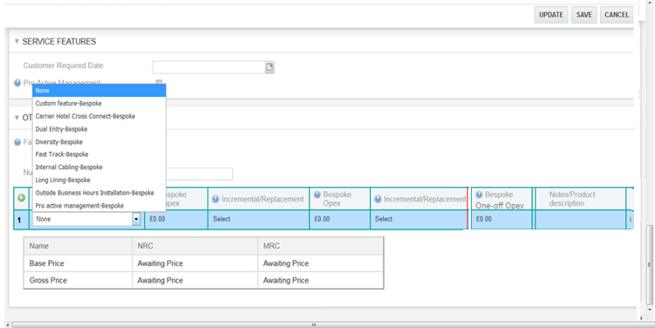
CPQ Asia : ULL Connectivity in Japan
Sales Engineer
SE will use the bespoke section to select the ‘Custom Feature-Bespoke’ drop value from the Bespoke Feature Column

Slide 10
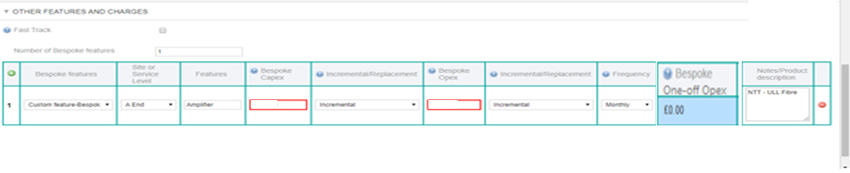
CPQ Asia : ULL Connectivity in Japan
Sales Engineer
SE can enter the component requirement in the Feature column. Feature Column is free text.
SE can enter the Opex and capex (for Asia SE can indicate a dummy value to trigger Commercial Operation for Price calculation)
This will trigger the deal pricing workflow where ‘Commercial Operations’ will get the appropriate charges for the ULL Fibre ‘NG’ scenarios.

Slide 11
CPQ Asia: Bespoke : One time Opex
One time opex field to be added in the bespoke journey
Please note: Introduction of one time opex has to be done across all the SE journeys. It should not have Incremental/ Replacement and Frequency columns

Slide 12
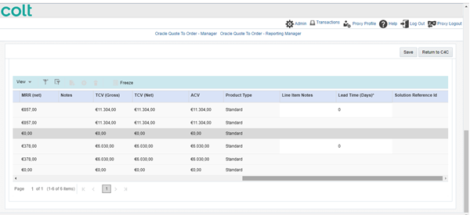
CPQ Asia: Bespoke : Rule update
The Solution Id reference field for the bespoke journey will be made optional across all product
Solution design document should be optional
Remove the validation that bespoke journey is only applicable if the technical complexity is 2 or above. System should allow the user to progress the bespoke journey even when the technical complexity is 1
The above rules should be implemented across all product and geographies

